Slide 1
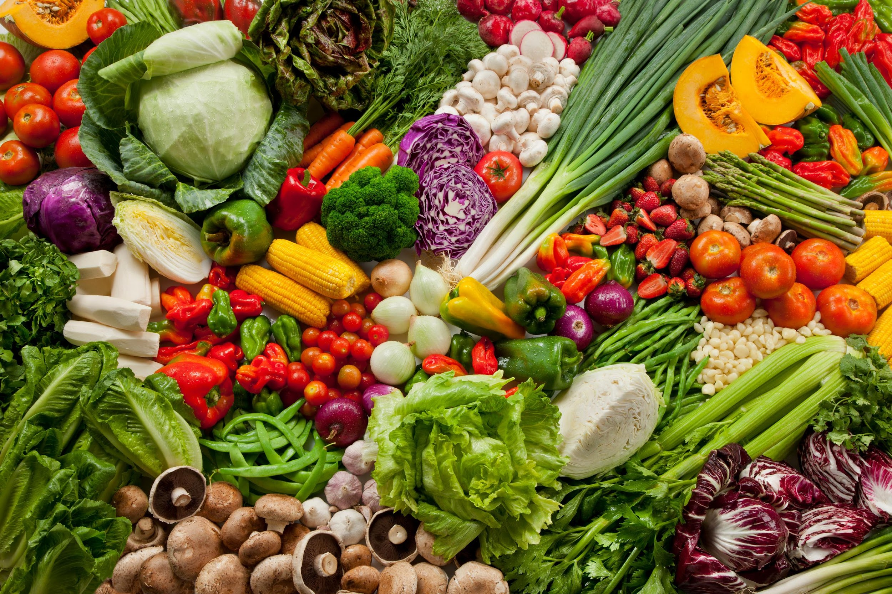
Enhancing Grocery Store Marketing with
Customer Segmentation
& Campaign Prediction
Ellie Zou, Joanne Zhou, Joanna Zhou, Tilly Hu
Notes:
Good afternoon, everyone. Today, we will be presenting our group project on enhancing grocery store marketing using customer segmentation and campaign prediction. My name is Ellie, and I’m joined by Joanne, Joanna, and Tilly.

Slide 2




Content
Business Problem
EDA & Insights
Clustering & Segmentation
Campaign Prediction
Recommendaction
Notes:
Here is our agenda today. Firstly, I’ll introduce the dataset and the exploratory data analysis. Then, we’ll show our clustering for customer segmentation, campaign prediction, and finally our recommendation.

Slide 3

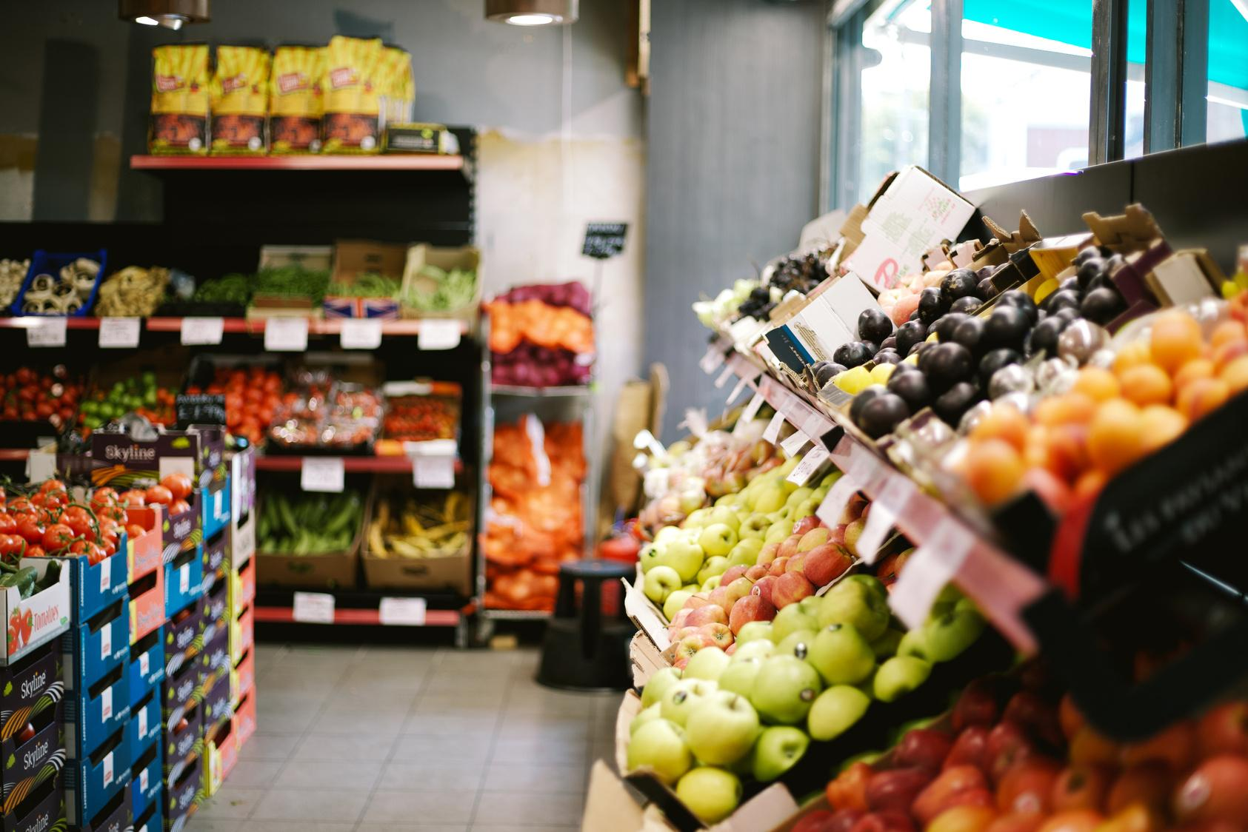



Business Problem
Our grocery store operates across multiple channels but struggles with low and inconsistent campaign engagement, making marketing optimization challenging. We aim to leverage ML and data-driven insights to enhance engagement, improve the shopping experience, and boost sales.
Notes:
We are a grocery store that sells a wide range of products through multiple channels, both in-store and online. However, we are facing challenges with sales growth. We had a low and inconsistent engagement in our promotional campaigns, making it difficult to optimize marketing strategies. Therefore, we aim to use ML methods and data-driven insights to improve customer engagement, enhance the shopping experience, and ultimately increase sales.

Slide 4
EDA & Insights
03
Channel
NumWebPurchases
NumCatalogPurchases
NumStorePurchases
Customer’s Info
ID
Age
Education
Marital_Status
Children
Dt_Customer
Recency
Complain
Products ($ Spent)
MntWines
MntFruits
MntMeatProducts
MntFishProducts
MntSweetProducts
MntGoldProducts
03
Promotion
NumDealsPurchases
AcceptedCmp1
...
Business Problem
EDA & Insights
Clustering & Segmentation
Campaign Prediction
Recommendation
Notes:
Our dataset consists of four key components: customer information, products spending, which acrosses various categories such as wine and fruit, purchase channels, and their response to promotional campaigns.

Slide 5
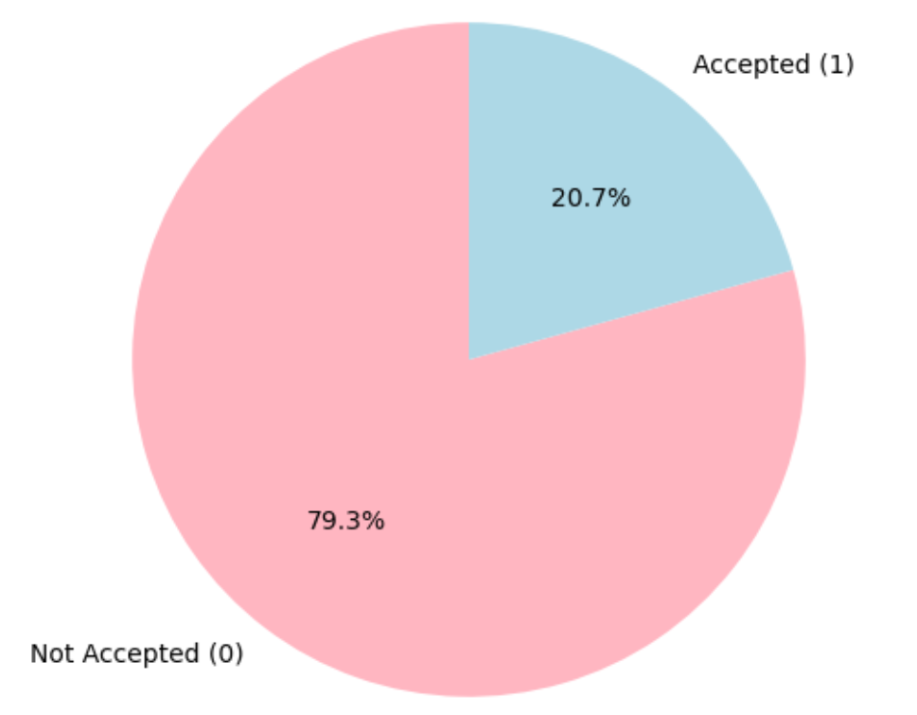
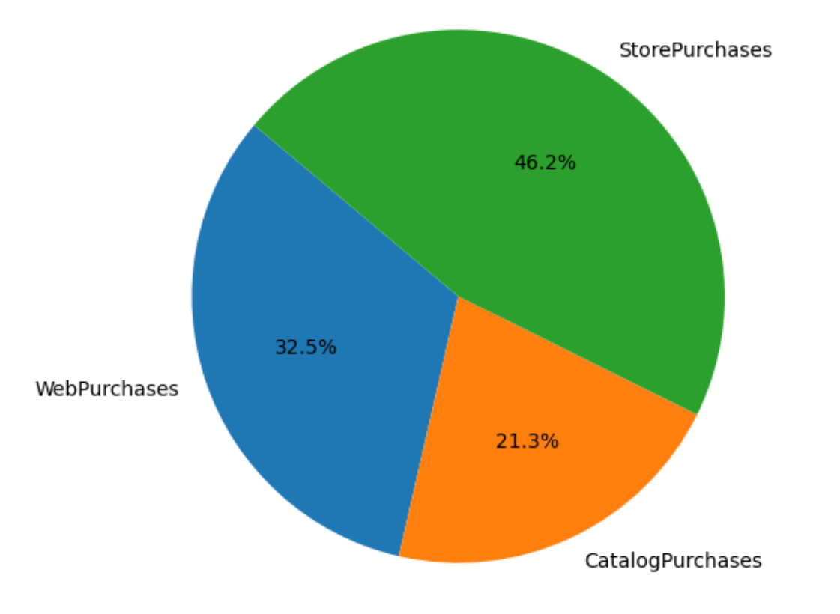
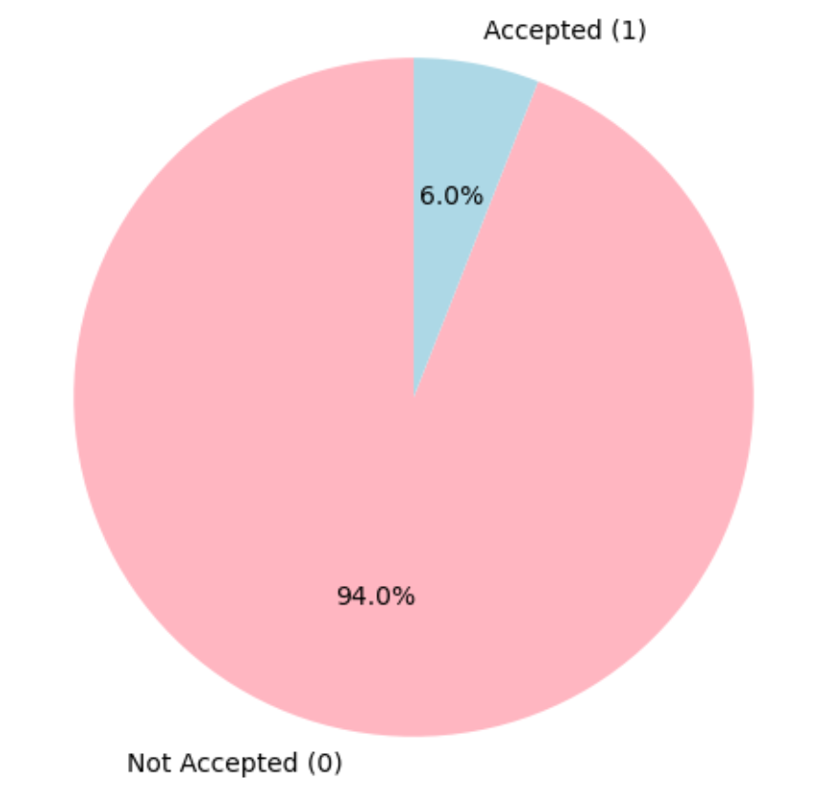
Percentage of Customers Accepting At Least One Campaign
EDA & Insights
03
Distribution of Purchases by Channel
Percentage of Acceptance Across All Campaigns
Business Problem
EDA & Insights
Clustering & Segmentation
Campaign Prediction
Recommendation
Notes:
To gain a deeper understanding of our customers, we conducted an exploratory data analysis. Firstly, we observed that in-store purchases are our primary sales channel, accounting for nearly half of all transactions.
The pie charts on the right illustrate two key insights: the Percentage of Customers Accepting at Least One Campaign and the average Percentage of Acceptance Across All Campaigns. While over 20% of customers responded to at least one promotion, the average acceptance rate for individual campaigns is only 6%.
This implies that although many customers are open to promotions, they are selective and only engage with offers that align with their specific interests. This highlights the need for more targeted and personalized marketing strategies to improve individual campaign effectiveness and overall customer engagement.

Slide 6
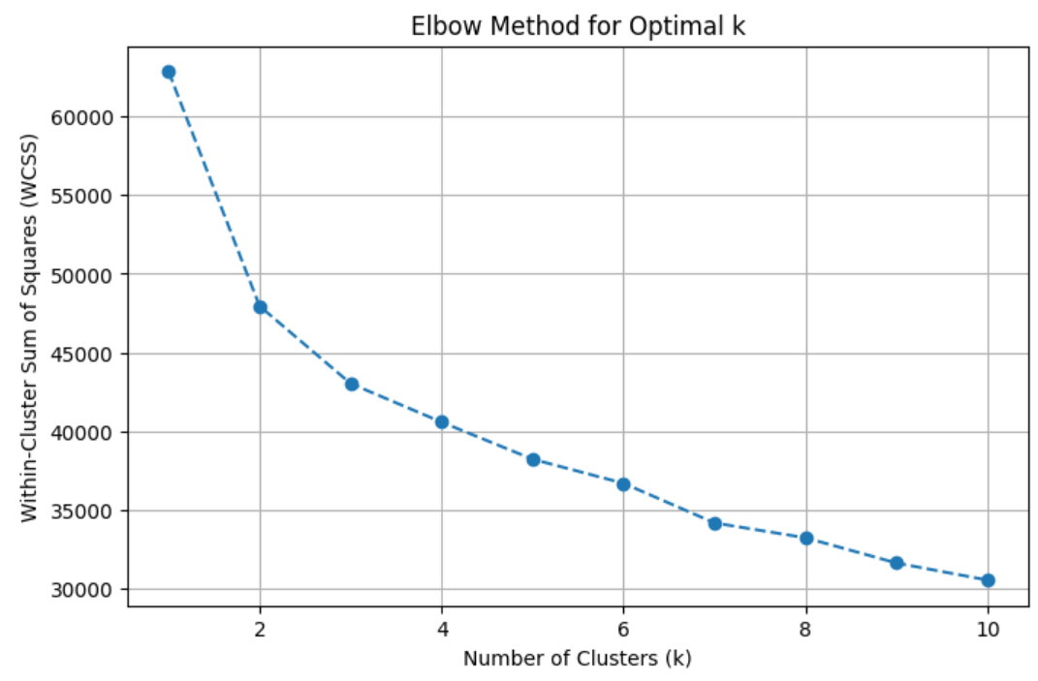
Best model: K-Means Clustering
03
Optimal k = 4
Metric | Silhouette Score | Davies-Bouldin Score
K-Means | 0.2277 | 1.8884
Hierarchical | 0.1457 | 1.9635
GMM | 0.1594 | 1.9064
DBSCAN | 0.0495 | 0.8763
Business Problem
EDA & Insights
Clustering & Segmentation
Campaign Prediction
Recommendation

Slide 7
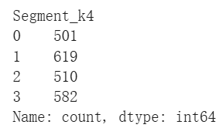
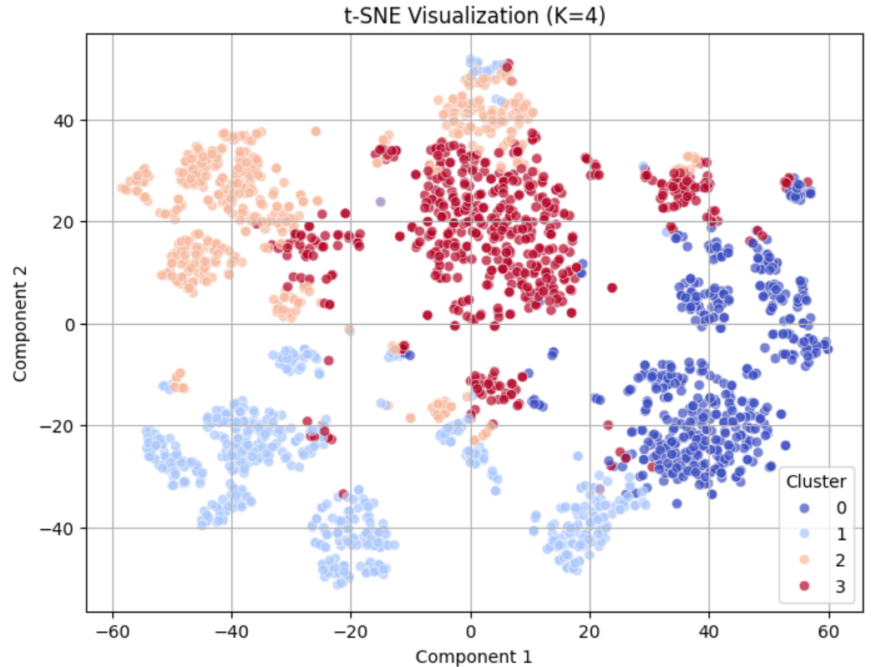
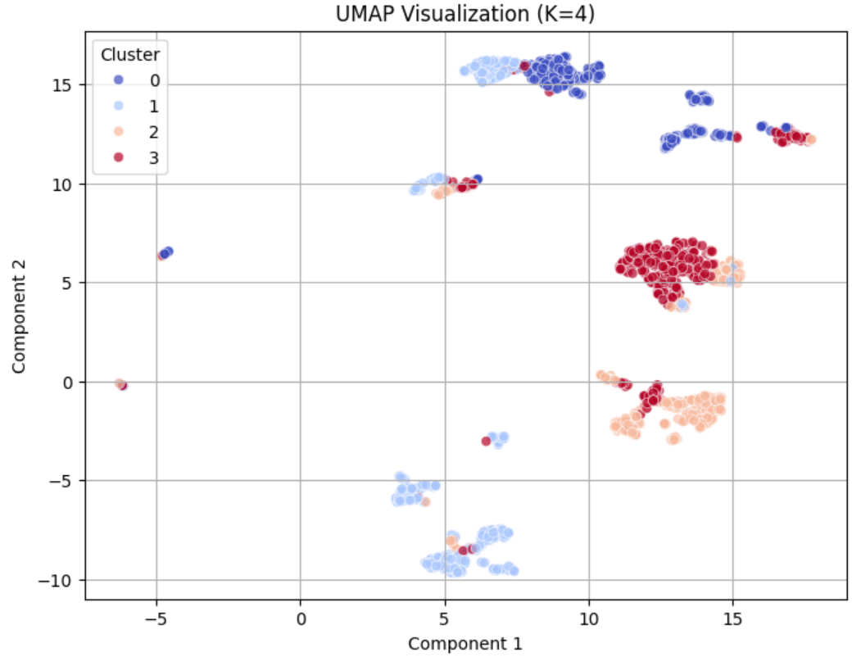
Model performance: t-SNE, UMAP
03
Jointly confirm K-Means model is a strong choice
Clusters are consistently well-separated across both visualizations
Cluster distribution remains stable across methods
Less overlap compared to hierarchical and GMM
Performance metrics (Silhouette & Davies-Bouldin) align with visual insights
Business Problem
EDA & Insights
Clustering & Segmentation
Campaign Prediction
Recommendation

Slide 8




Customer Profiling
03
Premium Shoppers
Budget-Conscious Young
Older, high-income, small households, no kids
High spenders, prefer premium products (wine, gourmet food)
Value exclusivity & convenience
Relatively more loyal
Younger, low-income, larger family
Highly price-sensitive
Most Frequent visits but least purchase
Senior Deal Hunters
Balanced Shopper
Oldest, moderate-income, largest family size
Infrequent visits but strategically looking for deals
High-value bundle buyers
Middle-aged, moderate-income, mid-sized families
Balanced spending, omnichannel shopper
Values convenience & variety
Business Problem
EDA & Insights
Clustering & Segmentation
Campaign Prediction
Recommendation
Notes:
Now that we’ve grouped our customers using K-Means clustering, let’s take a closer look at who they are
First up, we have Premium Shoppers. These customers tend to be older, have high incomes, and live in smaller households without kids. They prefer high-quality, premium products like fine wine and gourmet food. Convenience and exclusivity matter to them, and since they already spend more than most, they also tend to be more loyal to brands and stores that meet their expectations."
Budget-Conscious Young
"Next, we have the Budget-Conscious Young shoppers. This group is younger, from lower-income households, and often supporting larger families. they’re very price-sensitive. and interestingly, They visit the store the most but buy the least—. BUT Even though their individual purchases are small, their frequent visits make them a active group."
Senior Deal Hunters
"Then, we have the Senior Deal Hunters. These are our oldest customers, with moderate incomes and the largest family sizes. They don’t shop as often, but when they do, they make it count. Instead of frequent small purchases, they love looking for deals and often buy in bulk."
Balanced Shoppers
"And finally, we have the Balanced Shoppers—a middle-ground between all the other groups. These customers are middle-aged, with moderate incomes and mid-sized families. They balance their spending, mixing both essentials and premium products. And they appreciate variety and convenience in their shopping experience."

Slide 9
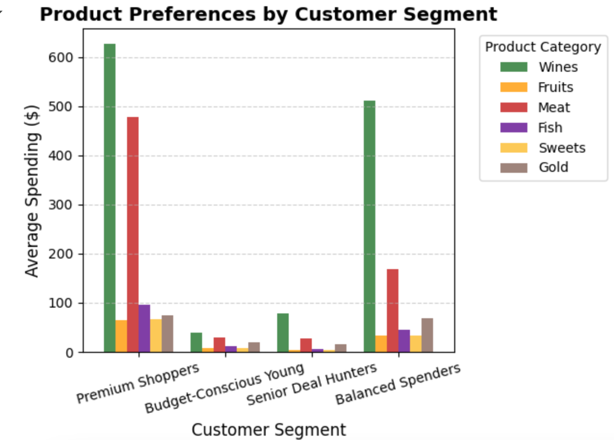
Marketing Mix by Segment
03
Product
Premium Shoppers & Balanced Spenders:
High share on Wines & Meat, diverse purchase, mix of essential & premium
Budget-Conscious Young & Senior Deal Hunters:
Minimal spending, slightly more on affordable essentials.
Business Problem
EDA & Insights
Clustering & Segmentation
Campaign Prediction
Recommendation
Notes:
Now that we understand our customer segments, let’s dive into how they interact with different product categories.
Premium Shoppers and Balanced Shoppers tend to have a mixed basket—they’re picking up both everyday essentials and higher-end products, with a clear preference for things like wine and meat.
On the other hand, Budget-Conscious Young and Senior Deal Hunters are more focused on the basics, spending as little as possible on premium items
So while some shoppers enjoy indulging in high-quality products, others are making every dollar count. This difference really shapes how we think about product positioning

Slide 10
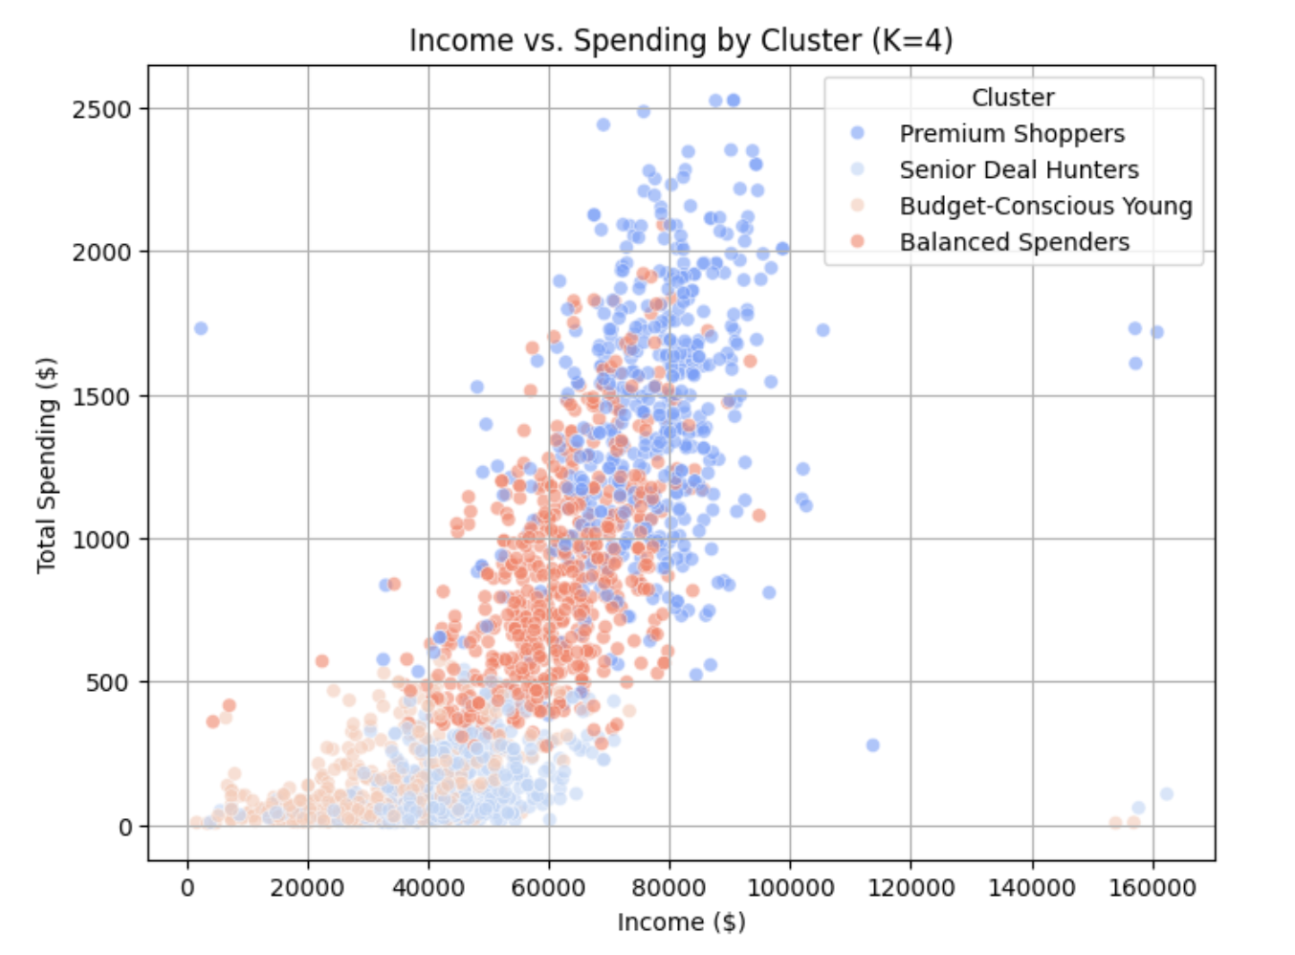
Marketing Mix by Segment
03
Price Sensitivity
Premium Shoppers:
Highest income and spending
Budget-Conscious Young:
Lowest income and Spending
Senior Deal Hunters:
Moderate income but low spending
Balanced Spenders:
Moderate income and spending
Business Problem
EDA & Insights
Clustering & Segmentation
Campaign Prediction
Recommendation
Notes:
*"Price sensitivity also varies across our customer groups:
Premium Shoppers have the highest income and spending, meaning they’re less sensitive to price changes.
Budget-Conscious Young shoppers are completely the opposite. tehy are the most price-sensitive, carefully considering every purchase. Senior Deal Hunters have moderate incomes, but they’re all about getting the most for their money, so they tend to buy only when they see a good deal
Balanced Shoppers fall somewhere in between, with moderate income and spending, making them more flexible with their purchasing decisions.

Slide 11
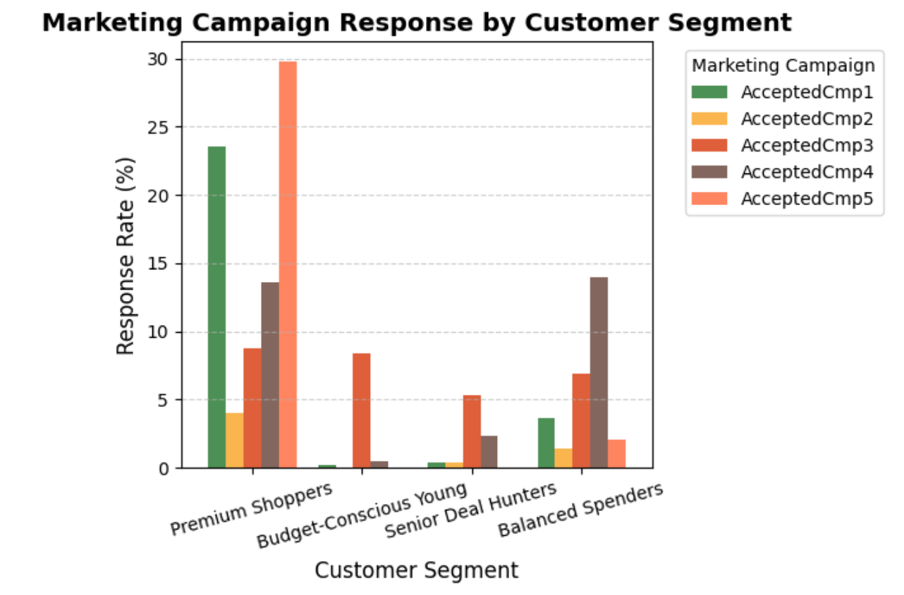
Marketing Mix by Segment
03
Promotion
Premium Shoppers:
~20%
Balanced Spenders:
~10%
Budget-Conscious Young & Senior Deal Hunters:
<5%
potential for low-end discount
Business Problem
EDA & Insights
Clustering & Segmentation
Campaign Prediction
Recommendation
Notes:
When it comes to promotions, some groups jump at the chance, while others barely notice.
Premium Shoppers and Balanced Shoppers engage with promotions at a moderate level, around 20% and 10%, respectively. Meanwhile, Budget-Conscious Young and Senior Deal Hunters—who are the ones we’d expect to care most about discounts—actually respond the least, at 5% or lower.
At first, this seems surprising, but it makes sense. These shoppers aren’t waiting for promotions—they’re already hunting for low prices on their own.
But here comes opportunity: this low engagement doesn’t mean they’re uninterested in discounts—it just means our current promotions might not be reaching them effectively. There’s a huge potential to refine our approach and create promotions that truly capture their attention and drive engagement.

Slide 12
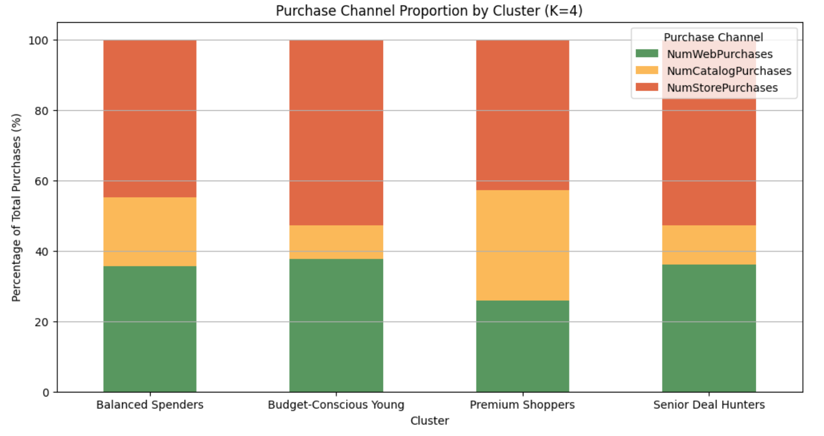
Marketing Mix by Segment
03
Place
Premium Shoppers
higher catalog share
suggesting a preference for personalized, high-end offerings
Budget-Conscious Young & Senior Deal Hunters:
Highly rely on in-store purchase for deals
Balanced Spenders:
omni-channel
Business Problem
EDA & Insights
Clustering & Segmentation
Campaign Prediction
Recommendation
Notes:
And finally, where do these shoppers prefer to buy?
Premium Shoppers love shopping through catalogs, which suggests they enjoy a more personalized, high-end shopping experience.
Budget-Conscious Young and Senior Deal Hunters are all about in-store shopping. They want to see the deals for themselves and compare prices in real-time.
Balanced Shoppers, as their name suggests, shop everywhere—online, in-store, and through catalogs. They’re the most flexible in terms of shopping habits.

Slide 13
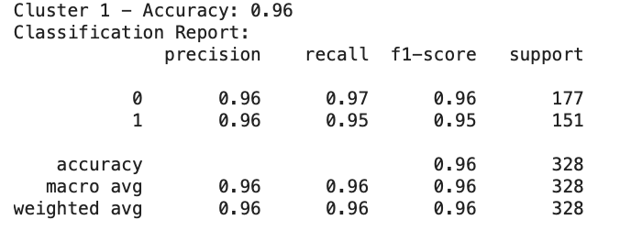
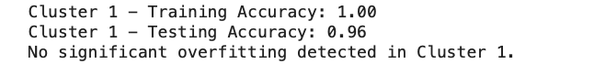
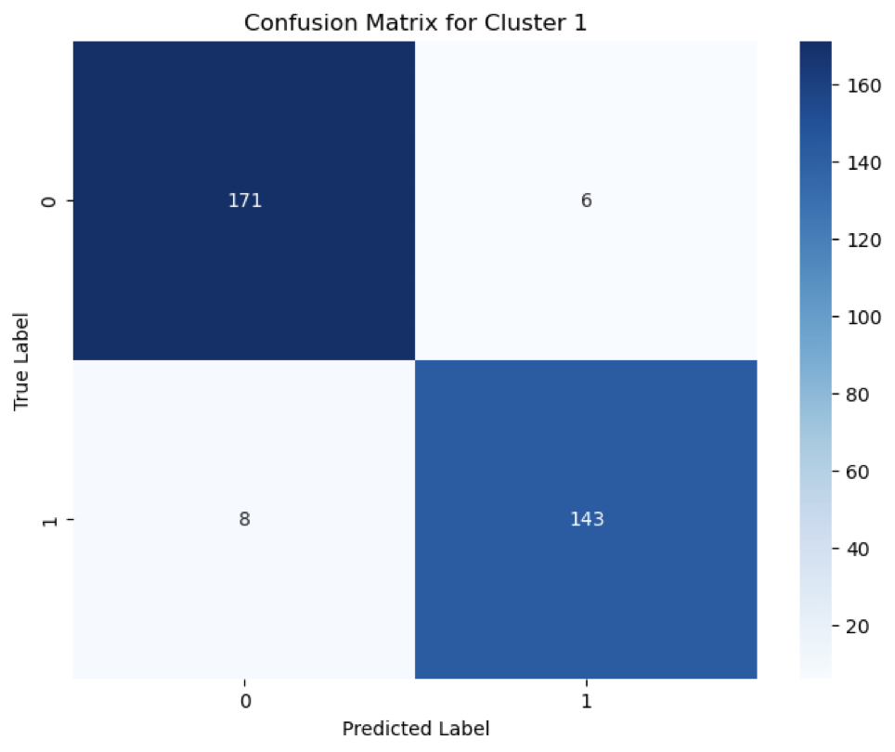
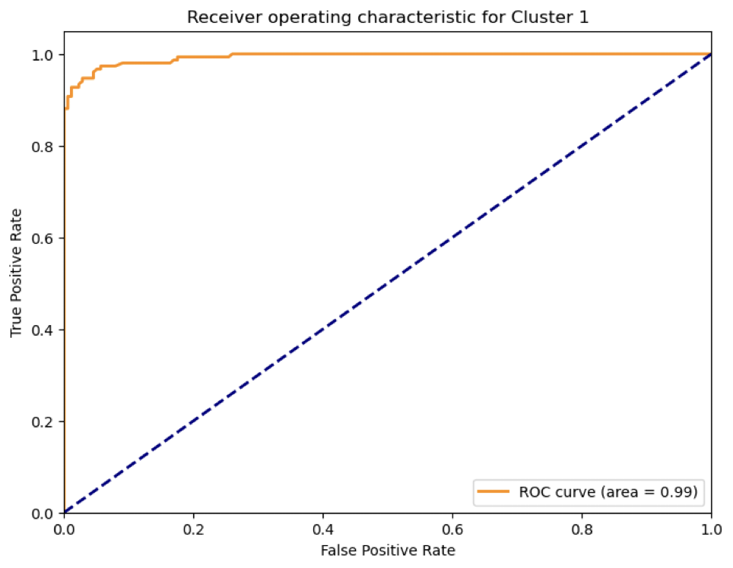
Campaign Prediction
03
Model Training:
Applies Random Forest Classifier with GridSearchCV for hyperparameter tuning.
Optimizes parameters to find the best model.
Model Evaluation:
Evaluates performance using Accuracy, Classification Report, and Confusion Matrix.
Checks for overfitting by comparing training and testing accuracy.
Generates AUC-ROC Curve to assess the model's ability to distinguish between classes.
Business Problem
EDA & Insights
Clustering & Segmentation
Campaign Prediction
Recommendation
Notes:
For example, in cluster 1, Our model is 96% accurate in distinguishing between responders and non-responders.
This is a strong indicator of a high-performing model, suitable for real-world deployment.
We can confidently use this model to target high-response customers, optimizing marketing spend and improving ROI.

Slide 14
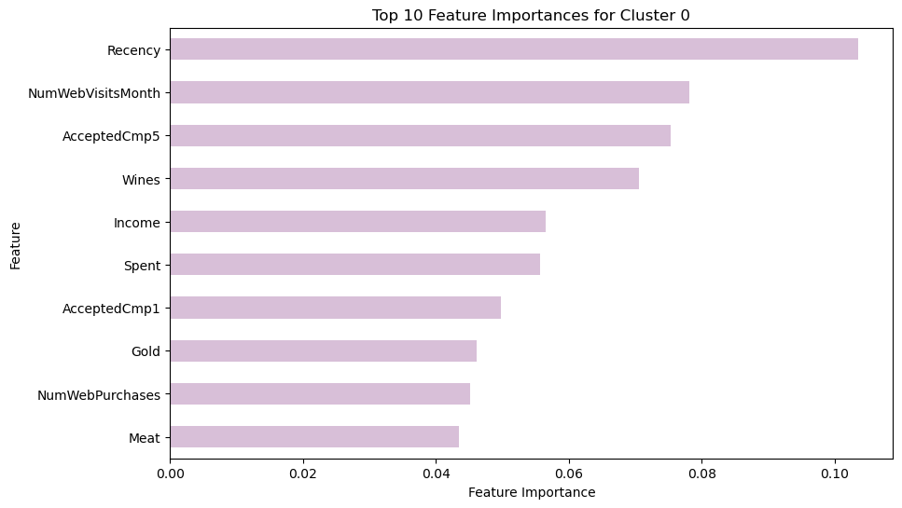
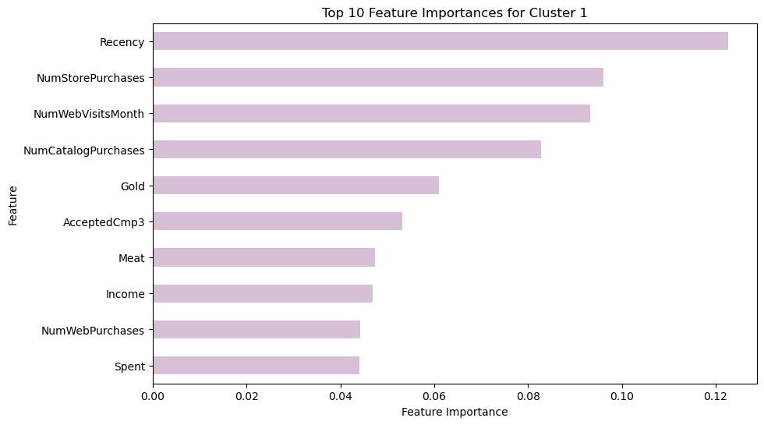
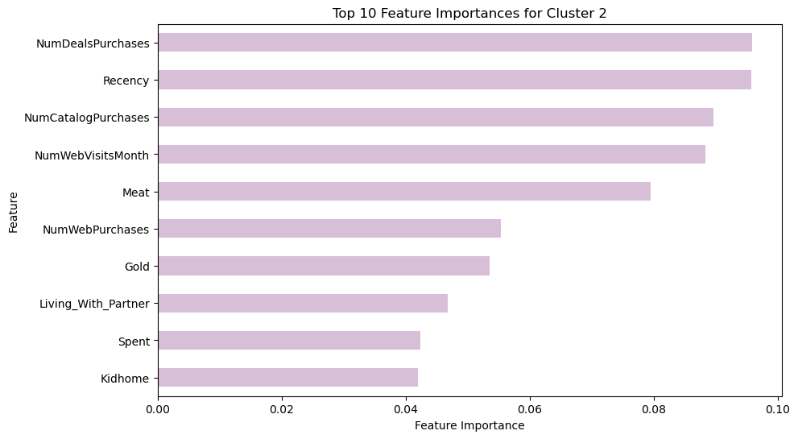
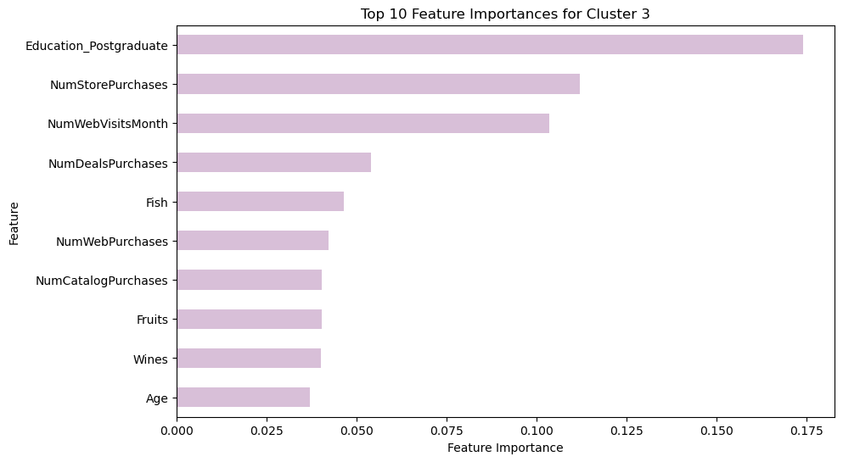
Top 10 Features for Each Cluster
03
Premium Shoppers
Budget-Conscious Young
Senior Deal Hunters
Balanced Shoppers
Business Problem
EDA & Insights
Clustering & Segmentation
Campaign Prediction
Recommendation

Slide 15
Recommendation
03
Premium Shoppers
Budget-Conscious Young
Key Features: Respond well to recent promotions and high-end products.
Strategy: Launch VIP programs, premium bundles, and early-access sales. Use personalized recommendations for luxury products.
Key Features: Shop frequently for discounts, both online and offline.
Strategy: Offer family bundles, discount promotions, and free shipping to attract price-sensitive shoppers.
Senior Deal Hunters
Balanced Shoppers
Key Features: Prefer discounted essentials and shop through catalogs and online.
Strategy: Provide senior discounts, simplify online checkout, and promote deals through multiple channels.
Key Features: Shop flexibly across channels and prefer diverse products.
Strategy: Use hybrid promotions, personalized offers, and cross-channel discounts to enhance shopping convenience.
Business Problem
EDA & Insights
Clustering & Segmentation
Campaign Prediction
Recommendation

Slide 16
Improvement
Model Development
Feature Importance
Deployment
Customer Segmentation:
Classify customers into clusters for tailored marketing.
Product Recommendations:
Use cluster insights to recommend relevant products.
Pricing & Promotions:
Optimize pricing and promotions based on cluster responses.
Data & Feature Engineering:
Continuously update data and features to reflect trends.
Model Refinement:
Regularly evaluate and retrain the model for better performance.
Dynamic Monitoring:
Track changes in feature importance over time.
Contextual Analysis:
Assess feature importance in different scenarios for deeper insights.

Slide 17
THANK YOU

Slide 18
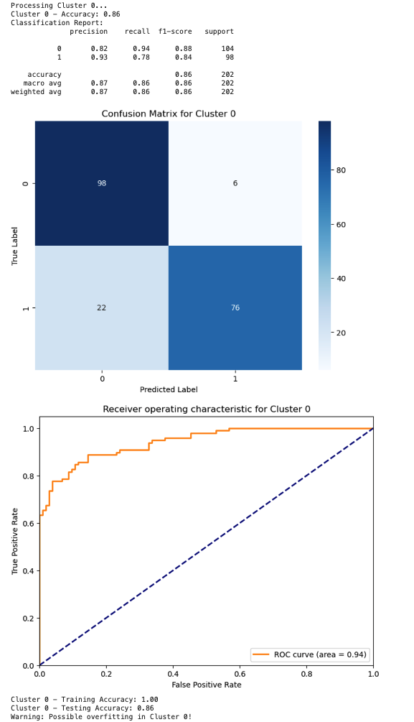
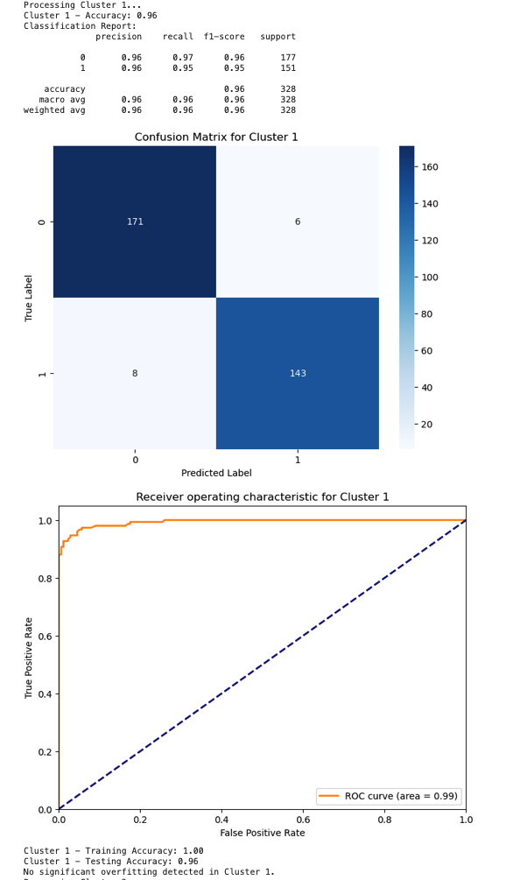
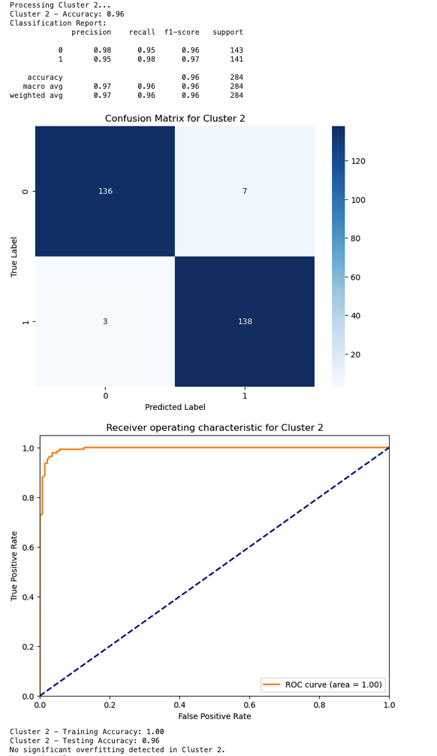

Appendix
Random Forest
03

Slide 19
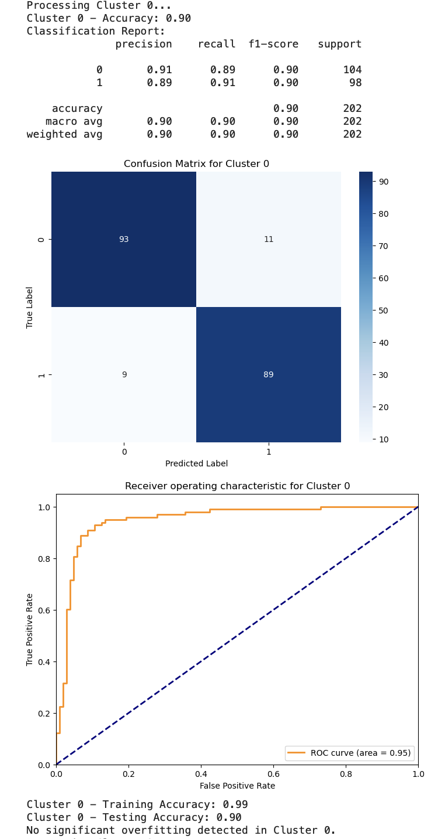
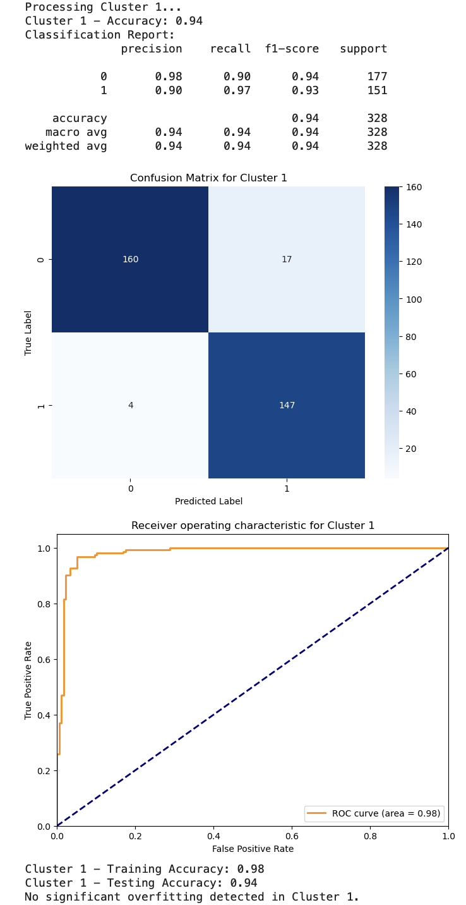
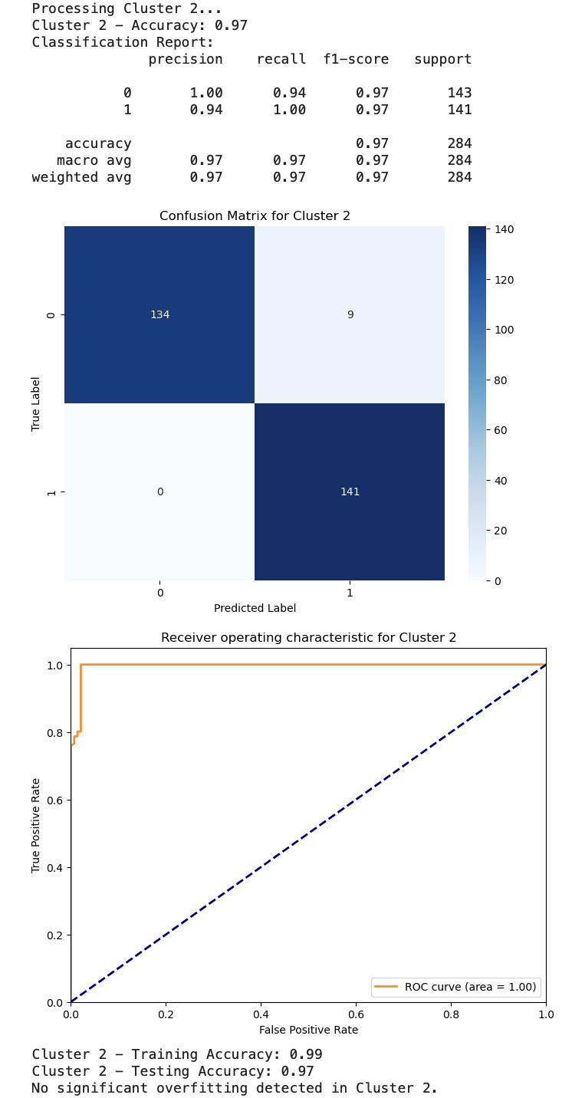
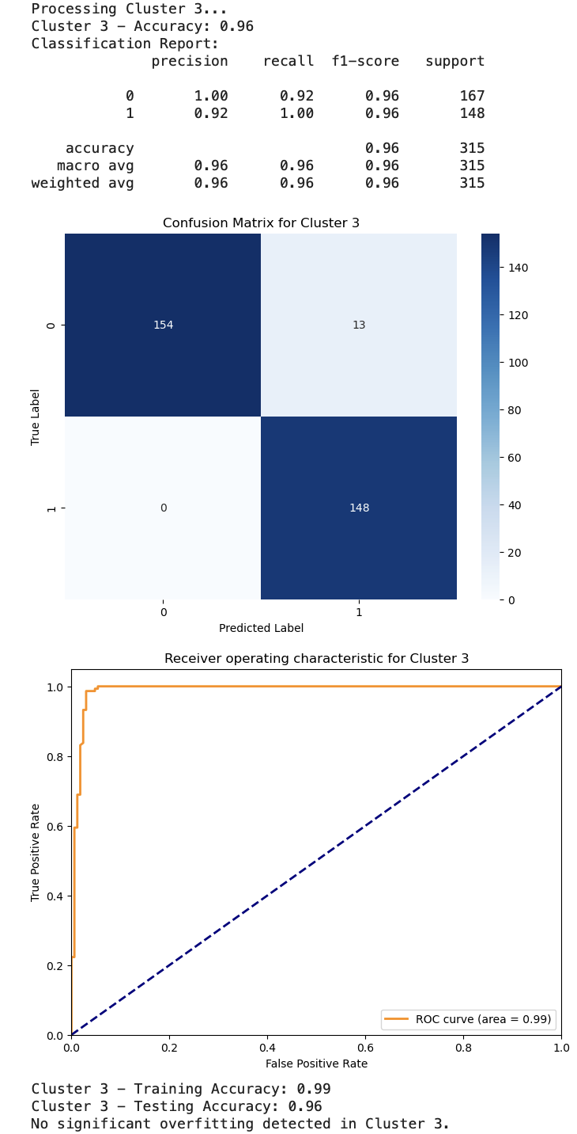
Appendix
SVM
03

Slide 20
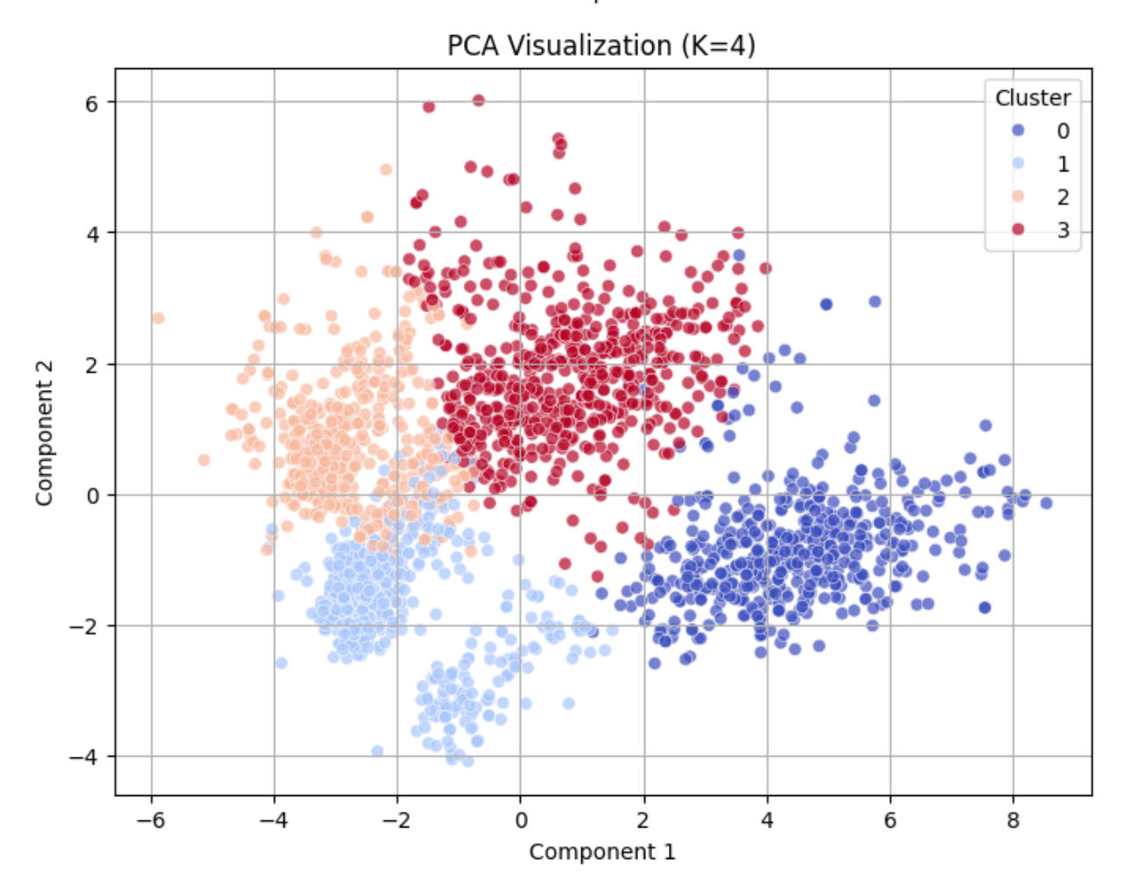
Appendix - K=4
03
https://docs.google.com/spreadsheets/d/1snVPhKFs-buUIon_h7S3_HFifOqQ-O2oSkzyPTm2LVE/edit?usp=drive_link

Slide 21
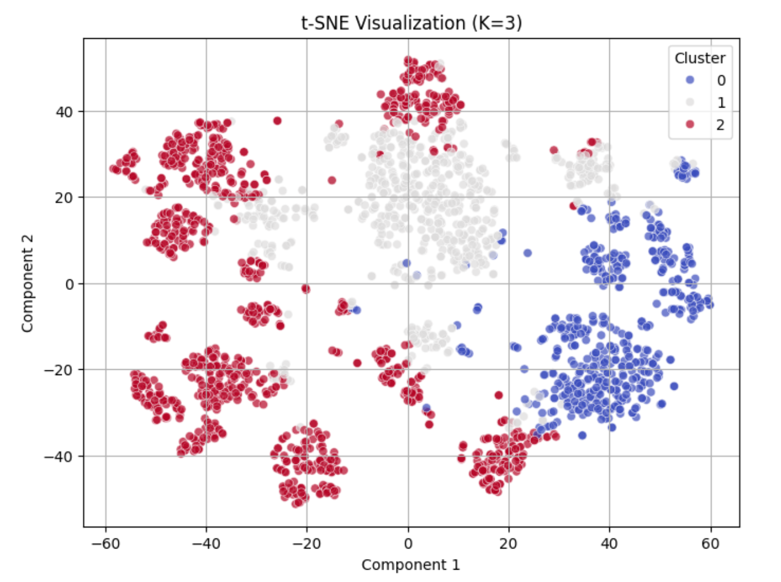
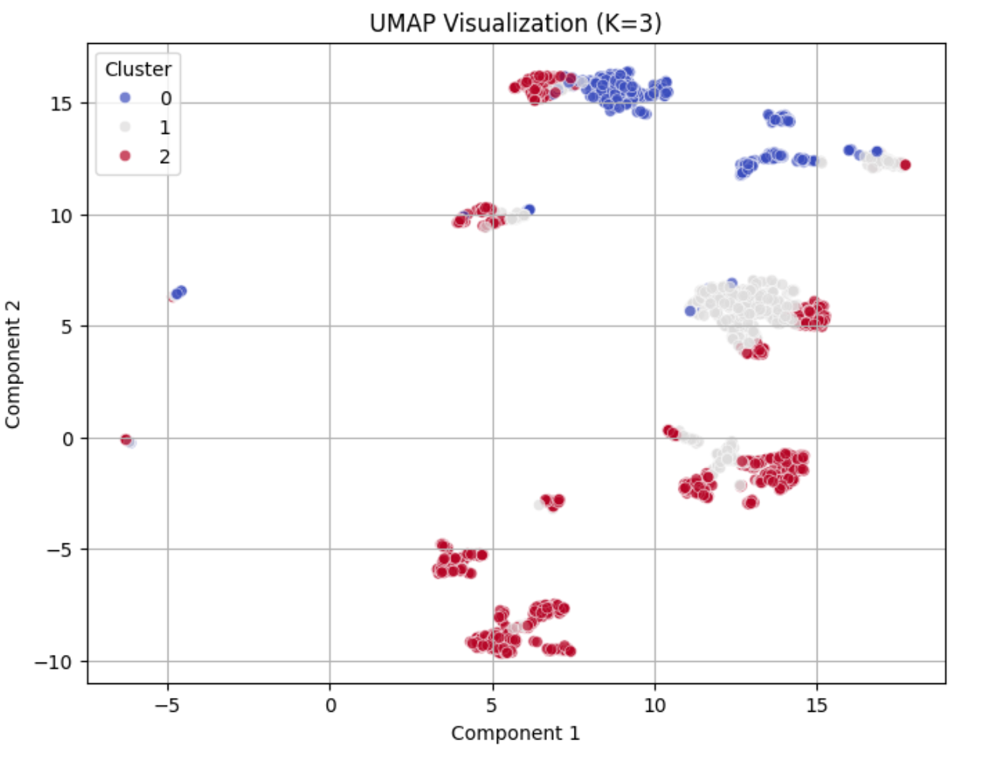
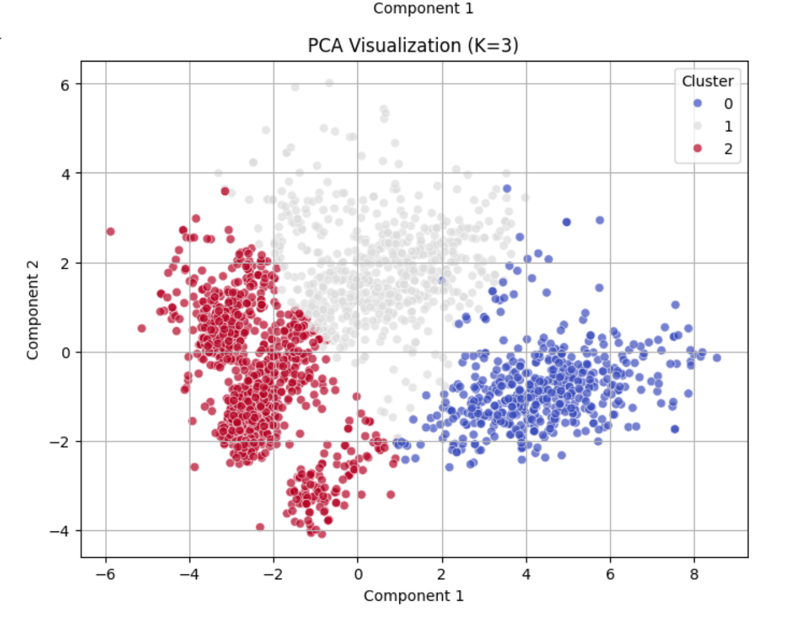
Appendix - K=3
03
https://docs.google.com/spreadsheets/d/1F3KmWcoglkfmJNcTBFIW4pEwhk5vUy5qGL0Qw6lOUuA/edit?usp=drive_link

Slide 22
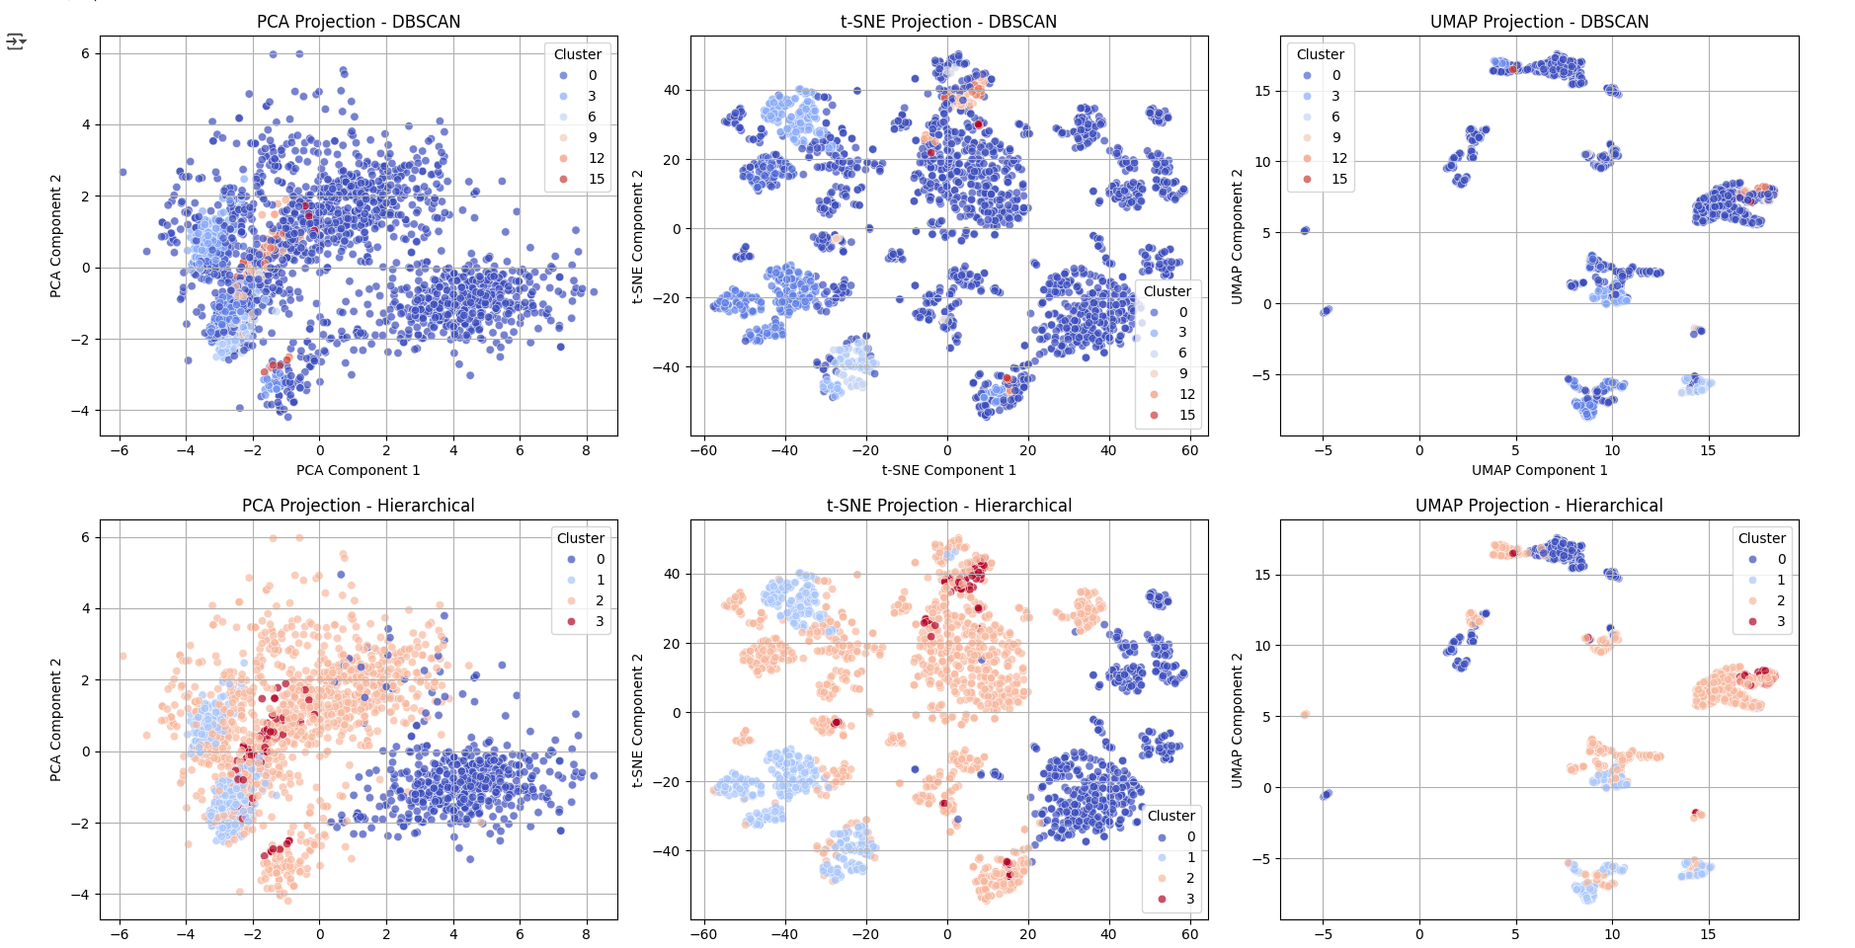
Appendix - Clustering
03

Slide 23
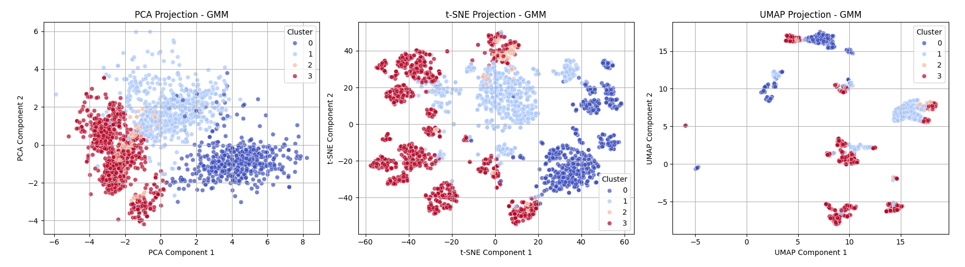
Appendix - Clustering
03

